Slide 1
SmartHeLP: Smartphone- based Hemoglobin Level Prediction Using an Artificial Neural Network
Link to paper

Slide 2
AIM
Existing Technologies and their Cons
Conclusion
To develop a method for practical, non-invasive and accurate determination of blood hemoglobin levels
Existing commercial devices such as Pronto®SpHb®(Masimo Corp.) or NBM 200 (OrSense)
but appear less accurate in complex clinical situations where non-invasive immediate test result capacity would be very useful
Smartphone-based noninvasive hemoglobin (Hb) measurement technologies, such as ToucHb, Masimo-Total Hemoglobin and Eyenaemia, suffer from one or more of the following limitations
data analysis and accuracy
data capturing and feature collection
affordability and portability
lack of user-friendliness and addition of external modules
They identified important feature locations, as well as reduced features, which can be used to make
the input for a dual-resolution (DR) CNN. Also they are developing a cloud-based hemoglobin estimation system

Slide 3
Image Processing Technique
Image Segmentation
Dataset
First, the frames from each fingertip video was extracted then red, green, and blue (RGB) pixels were separated for each frame.
Red, green and blue channel data were normalized dividing each pixel intensity by 255. The duration of each video was from 11 to 13 seconds, with 30 frames per second resulting in a range of 330-390 frames per fingertip video.
An image frame, for each color pixel, was divided into one hundred blocks and for each block the mean value of a single-color pixel was generated from every frame.
This calculation derived 300 mean values for three hundred frames for each block
There were 75 patients out of which 55 were women and 20 were men
Total data was divided into 70:15:15

Slide 4
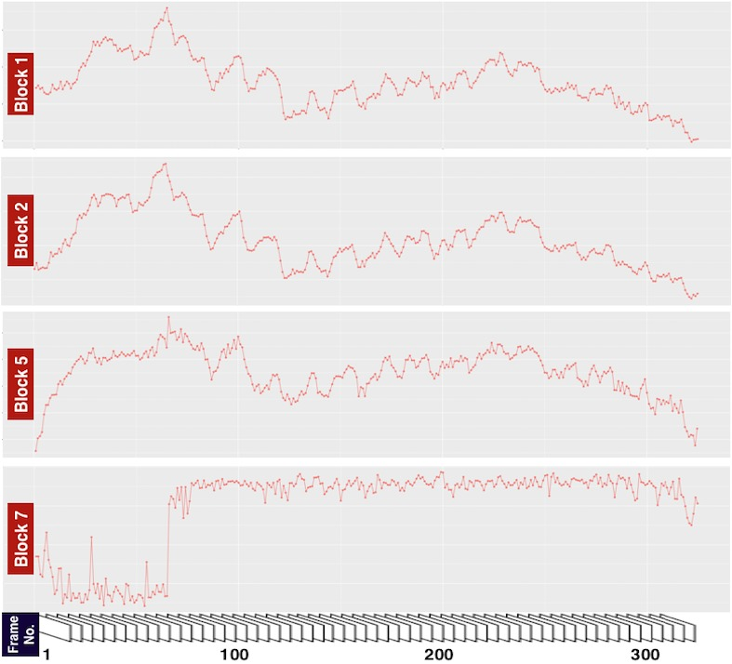
Observation
Feature Selection
Variation in mean pixel intensity of a specific block (55) over 300 frames
Random and wide intensity fluctuations were observed in early frames.Though subsequently, such fluctuations were rarely seen
Frame numbers 101 to 300 (total 200) are selected as input features

Slide 5
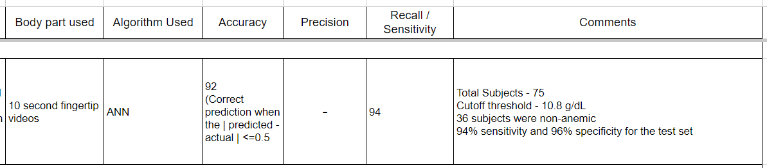
Conclusion
They identified important feature locations, as well as reduced features, which can be used to make the input for a dual-resolution (DR) Convolutional Neural Network (CNN).
Also they are developing a cloud-based hemoglobin estimation system using the fingertip video captured on a smartphone-based application

